Slide 1


Bangladesh University of Engineering & Technology
Department of Electrical and Electronic Engineering
EEE 414
Term: 4-2
Electrical Service Design
Prepared by
Saif Ahmed Sunny
Lecturer (PT) – January 2024
Department of EEE, BUET
EEE 414
1

Slide 2
AutoCAD

Slide 3

AutoCAD
BUET
1. Line drawing at a particular angle
2. Creating a square box (orthomode)
3. Deleting a Line (eraser or delete)
4. Deleting an extended portion (trim)
5. Drawing a door (arc)
6. Drawing parallel Line (offset)
7. Units

Slide 4
AutoCAD
BUET
7. Layers
8. Pan, Copy, Cut
9. Move, Rotate, Mirror
10. Osnap
11. Hatch
12. Dimension
13. Text
14. Creating Block

Slide 5
Project Proposal

Slide 6
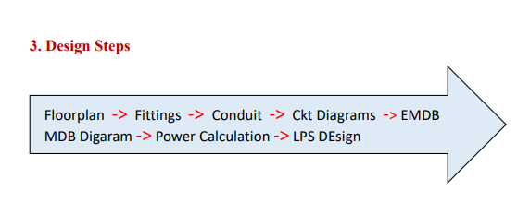
Project Map
BUET

Slide 7
Layers
Layer-1: Main Floorplan
Layer-2: Room Names
Layer-3: Dimensions
Layer-4: Doors and Windows
Layer-5: Light Fan
Layer-6: Power Sockets
Layer-7: Switchboards
Layer-9: Normal Conduit
Layer-10: Emergency Conduit

Slide 8
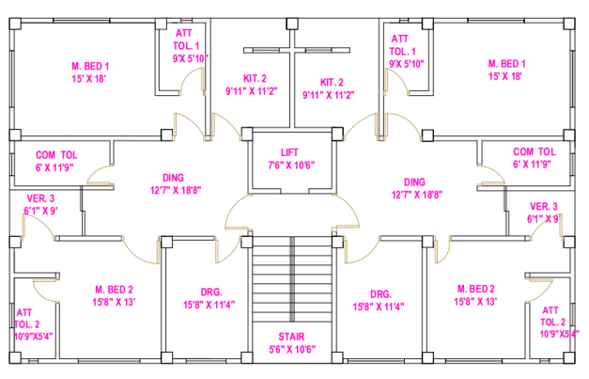
Main Floorplan
High Rise (9 Living Floor)
Min 2 units
Each unit min 1200 sq. ft.
Lift
Bedroom (2-3)
Washroom (min 2)
Kitchen
Dining
Drawing
Veranda

Slide 9
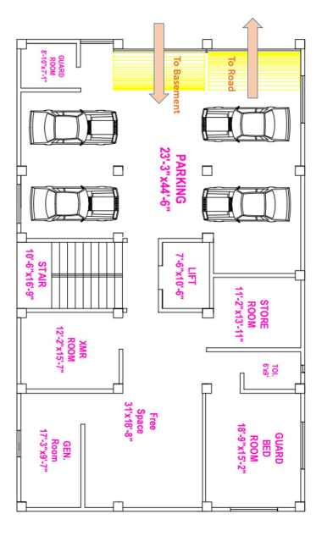
Ground Floorplan
Parking Space
Electrical Room
Transformer Room
Generator Room
Guard Room
Guard Bedroom
Washroom

Slide 10
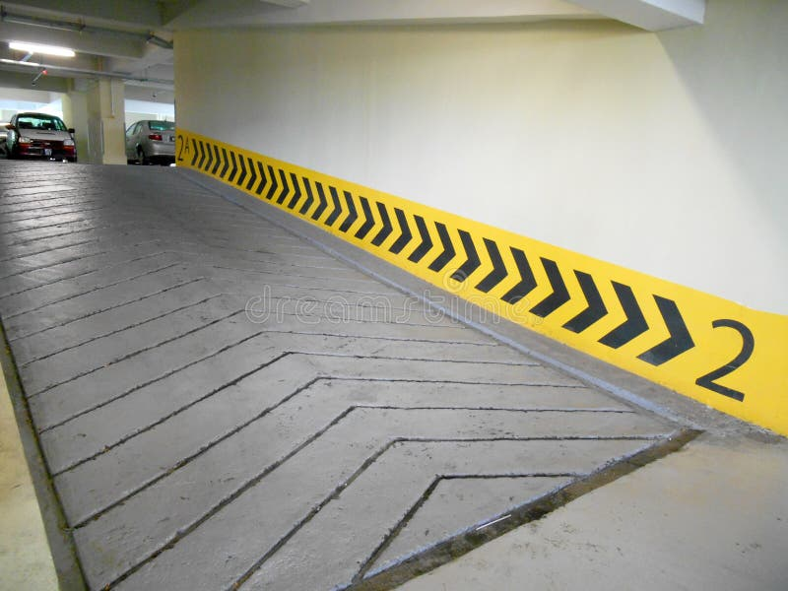
Ramp
Ground Floor
Basement

Slide 11
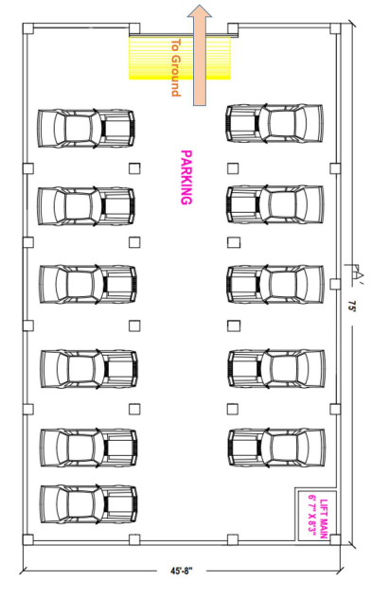
Basement/Garage
Parking Space
Store Room
Lift Maintenance Room

Slide 12
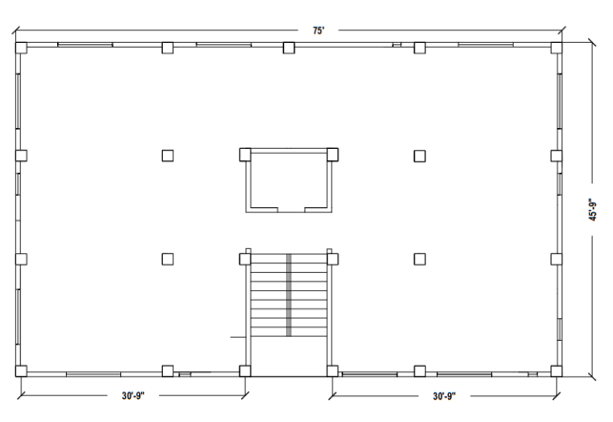
Roof
Beams
Lift Machine Room
Stairs
Mainly used for Lightning Protection System (LPS) Design

Slide 13
Fittings and Fixtures

Slide 14
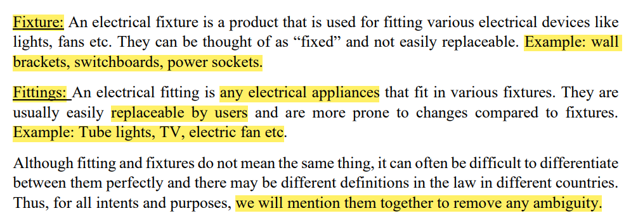
Fittings and Fixtures

Slide 15
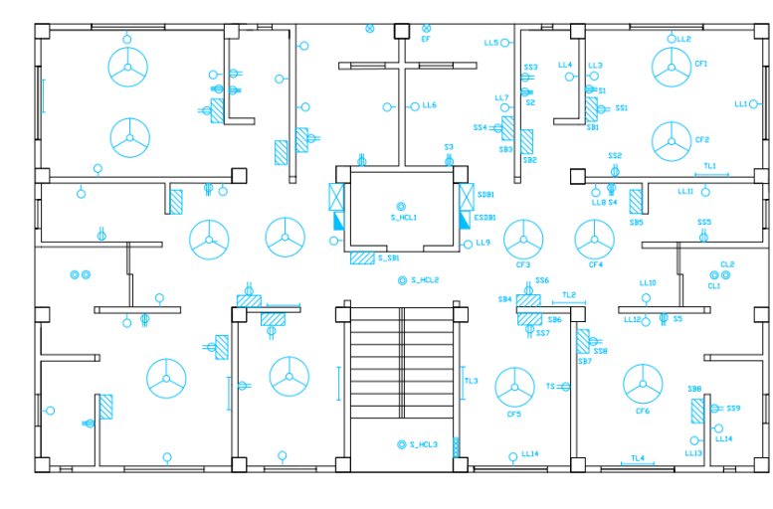
Fittings and Fixtures (Main Floorplan)

Slide 16
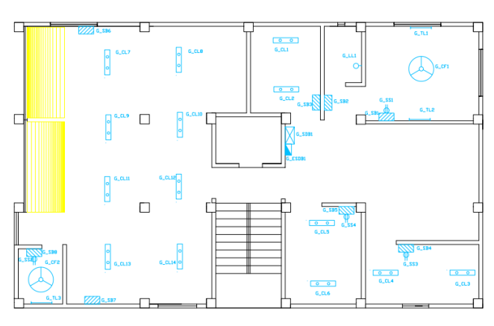
Fittings and Fixtures (Ground Floor)

Slide 17
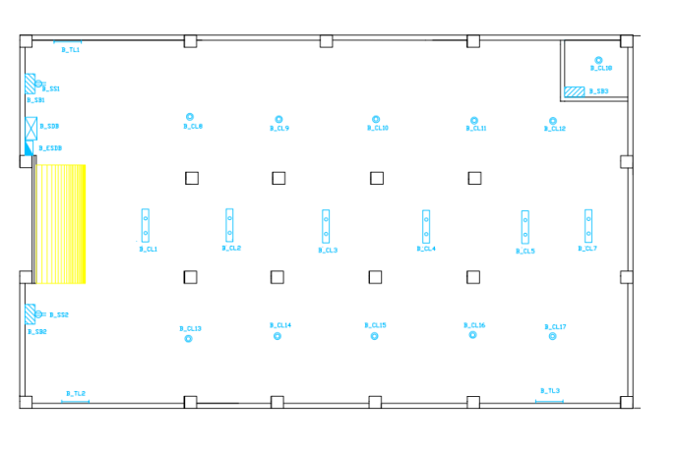
Fittings and Fixtures (Basement)

Slide 18
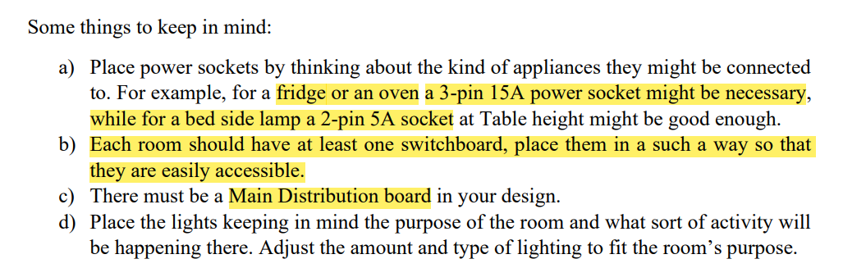
Fittings and Fixtures

Slide 19
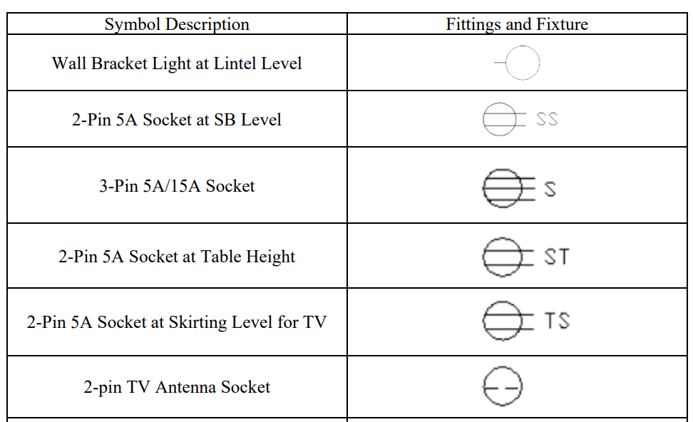
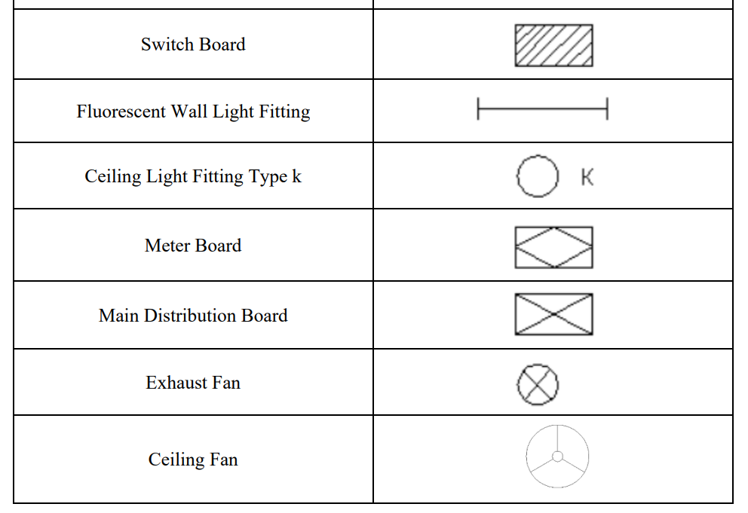
Fittings and Fixtures
Lights- 3” radius
Tube light – 3’ length
Ceiling fan – diameter 48” or 56” outer and 6” inner

Slide 20
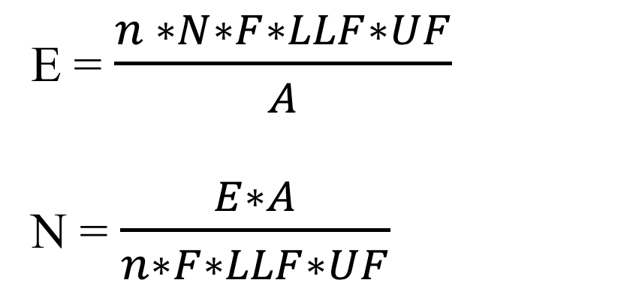
Light Calculation
N = Number of Lights
E = Illumination (lux = lm/m2) - Table
A = Area of the Room ( sq. meter )
n = lights per illuminaire
F = Lumen of Light
UF = Utilization Factor
LLF = Light Loss Factor
E = $\frac{n ∗N∗F∗LLF∗UF}{A}$
N = $\frac{E∗A}{n∗F∗LLF∗UF}$

Slide 21
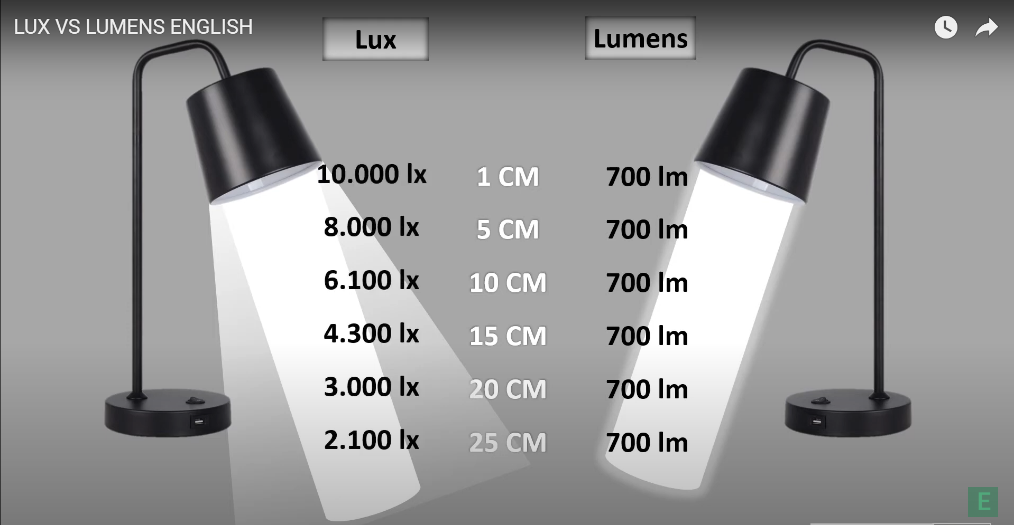
Lux vs Lumen
Lumen – Amount of Light a Bulb emits in all directions
Lux - Light per unit surface (Lumen/m2)
https://www.youtube.com/watch?v=rtPA9UeRANY

Slide 22
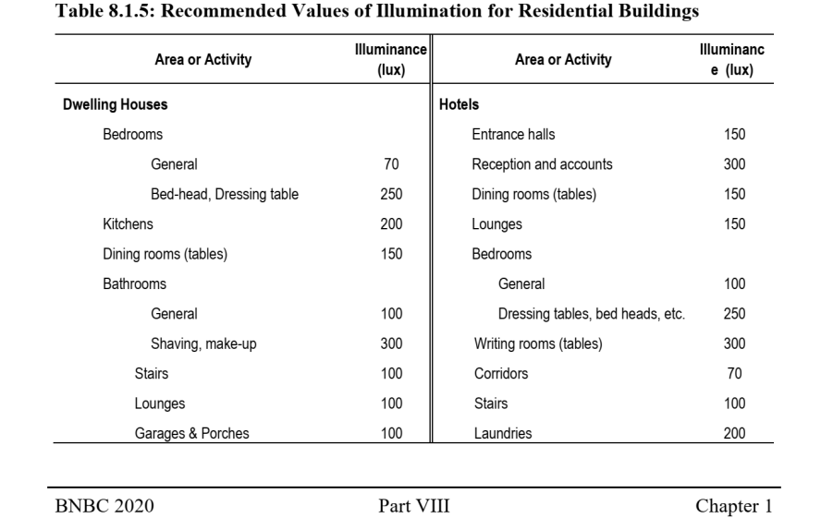
E – Illumination Table

Slide 23
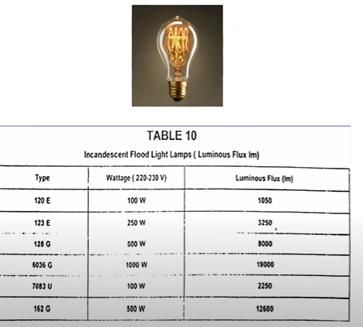
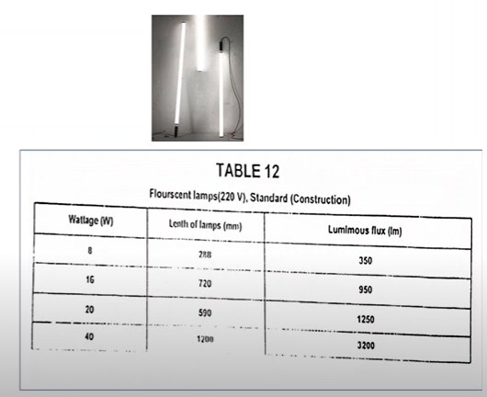
F- Lumen of Light (Watt vs Lumen Chart)
Incandescent Bulb
Fluorescent Bulb

Slide 24
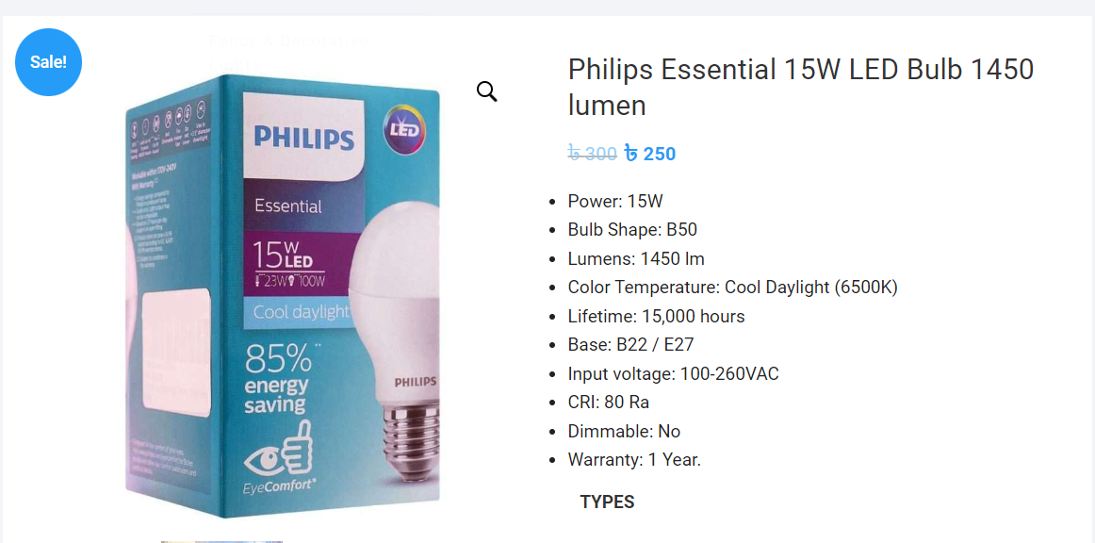
F- Lumen of Light (Watt vs Lumen Chart)
LED Bulb

Slide 25

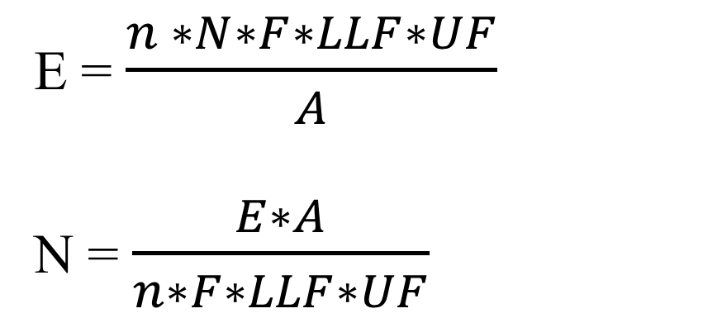
Light Calculation
E = $\frac{n ∗N∗F∗LLF∗UF}{A}$
N = $\frac{E∗A}{n∗F∗LLF∗UF}$
N = Number of Lights
E = Illumination (lux = lm/m2) - Table
A = Area of the Room ( sq. meter )
n = lights per illuminaire
F = Lumen of Light
UF = Utilization Factor
LLF = Light Loss Factor
n = 2
n = 1
UF*LLF = 0.75

Slide 26

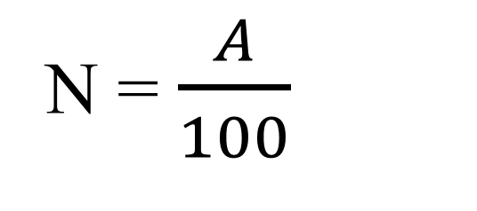
Fan Calculation
N = $\frac{A}{100}$
A = Area of the Room ( sq. feet )

Slide 27
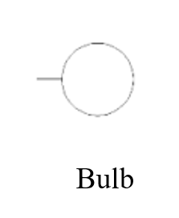
Sample Calculation
Example:
A Bedroom
Dimension A = L x W = 15 x 13 ft2 = 18.118 m2
Illuminance E = 100
Light Loss Factor and Utilization Factor LLF x UF = 0.75
Flux F = 1450 Lumen
Lights per illuminaire n = 1
Light N = 1.66
So, 2 LED Bulbs
Fan N = 1.95
So, 2 Fans

Slide 28
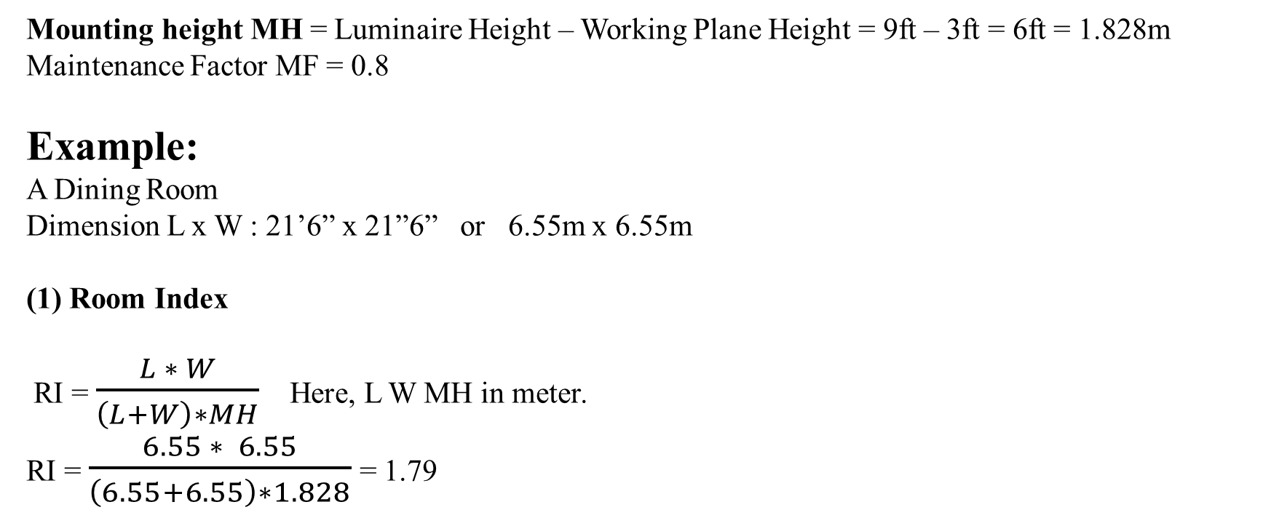
Fittings and Fixtures (Another Method)
Mounting height MH = Luminaire Height – Working Plane Height = 9ft – 3ft = 6ft = 1.828m
Maintenance Factor MF = 0.8
Example:
A Dining Room
Dimension L x W : 21’6” x 21”6” or 6.55m x 6.55m
(1) Room Index
RI = $\frac{L ∗ W}{\left(L+W\right)∗MH}$ Here, L W MH in meter.
RI = $\frac{6.55 ∗ 6.55}{\left(6.55+6.55\right)∗1.828}$ = 1.79

Slide 29
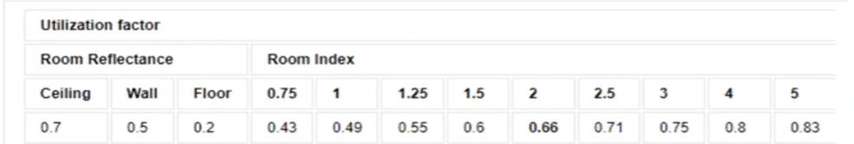
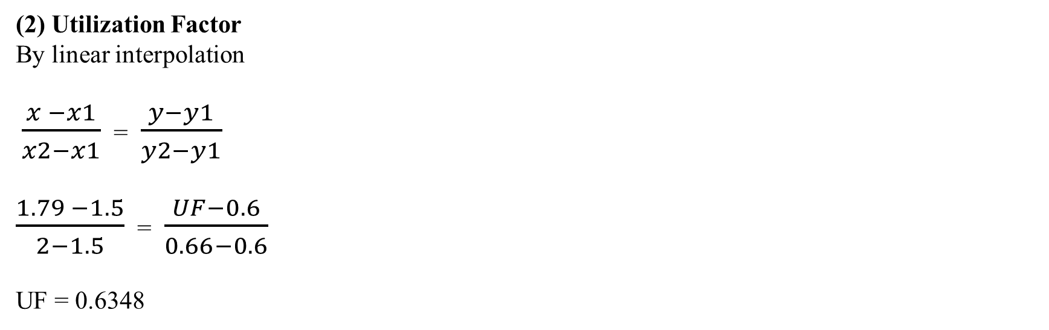
Fittings and Fixtures (Another Method)
(2) Utilization Factor
By linear interpolation
$\frac{x −x1}{x2−x1}$ = $\frac{y−y1}{y2−y1}$
$\frac{1.79 −1.5}{2−1.5}$ = $\frac{UF−0.6}{0.66−0.6}$
UF = 0.6348

Slide 30
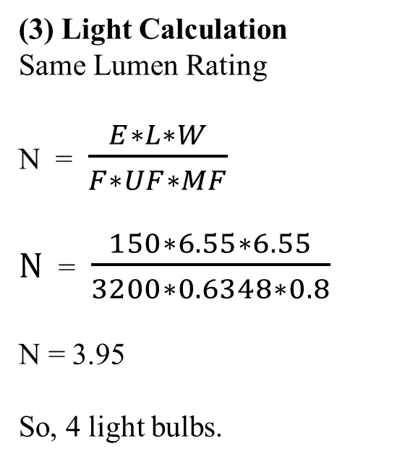
Fittings and Fixtures (Another Method)
N = Number of Lights
E = Lux of the Room = 150 lux
L = Length in meter = 6.55m
W = Width in meter = 6.55m
F = Lumen of Light = 3200 lm
UF = Utilization Factor = 0.6348
MF = Maintenance Factor = 0.8
(3) Light Calculation
Same Lumen Rating
N = $\frac{E∗L∗W}{F∗UF∗MF}$
$N$ = $\frac{150∗6.55∗6.55}{3200∗0.6348∗0.8}$
N = 3.95
So, 4 light bulbs.

Slide 31
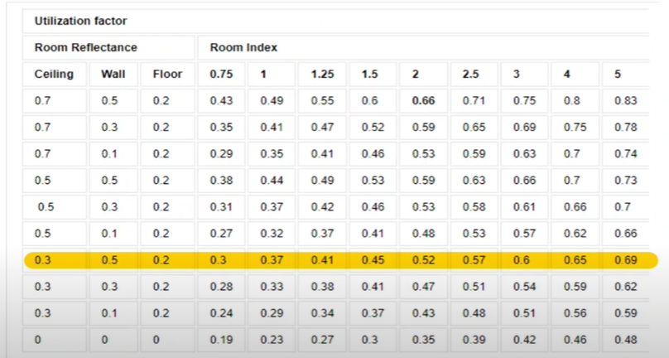
Fittings and Fixtures (Another Method)

Slide 32
Conduit

Slide 33
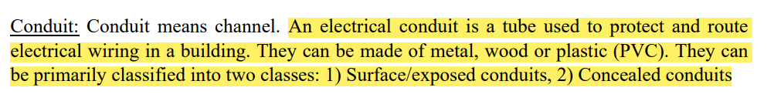
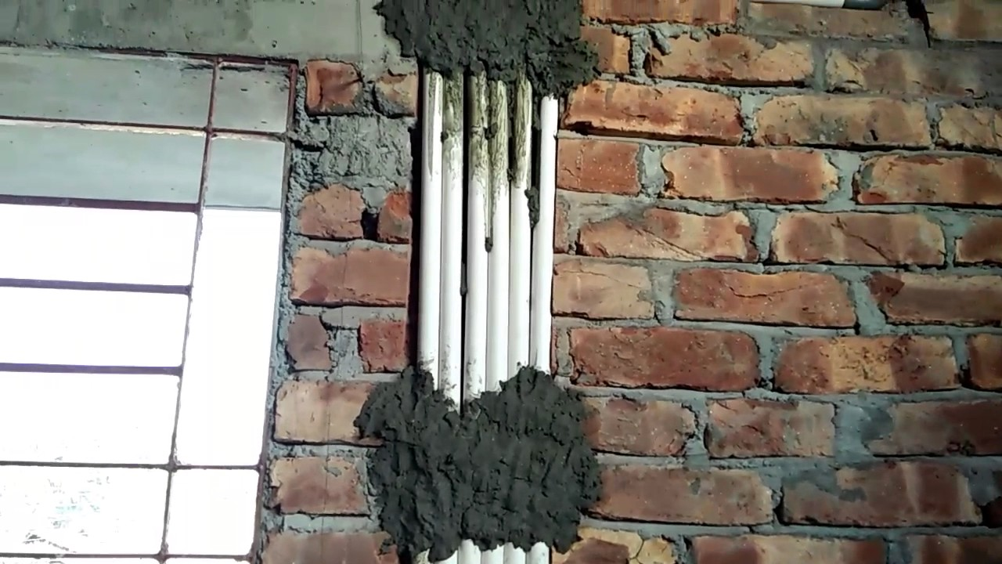
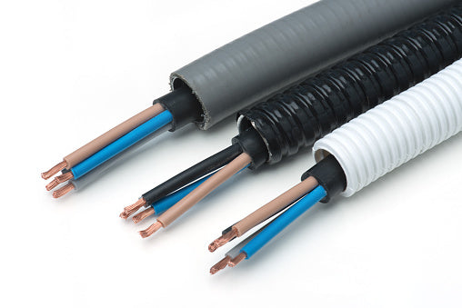
Conduit

Slide 34
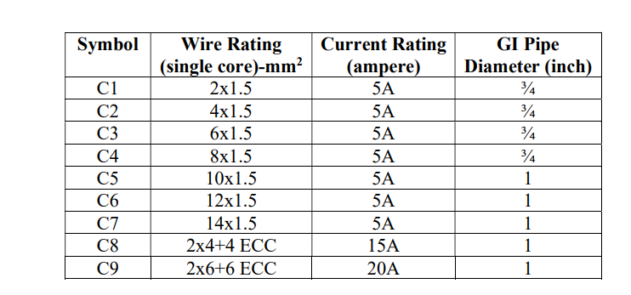
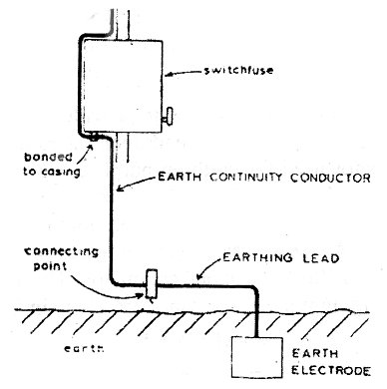
Conduit
ECC- Earth Continuity Conductor
ECC is not needed for the conduits from SB to Light, Fan and 2pin Sockets (C1 – C7)
ECC is needed for power sockets (C8, C9) and all the wires after SB

Slide 35
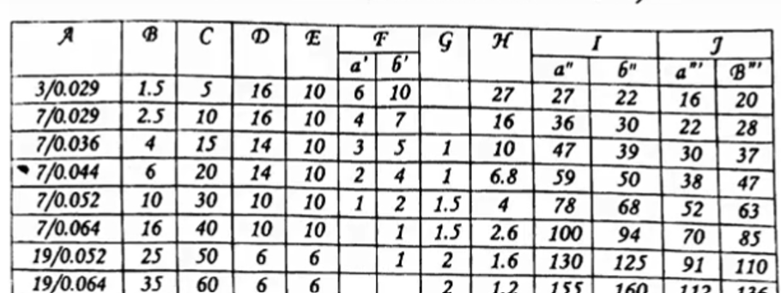
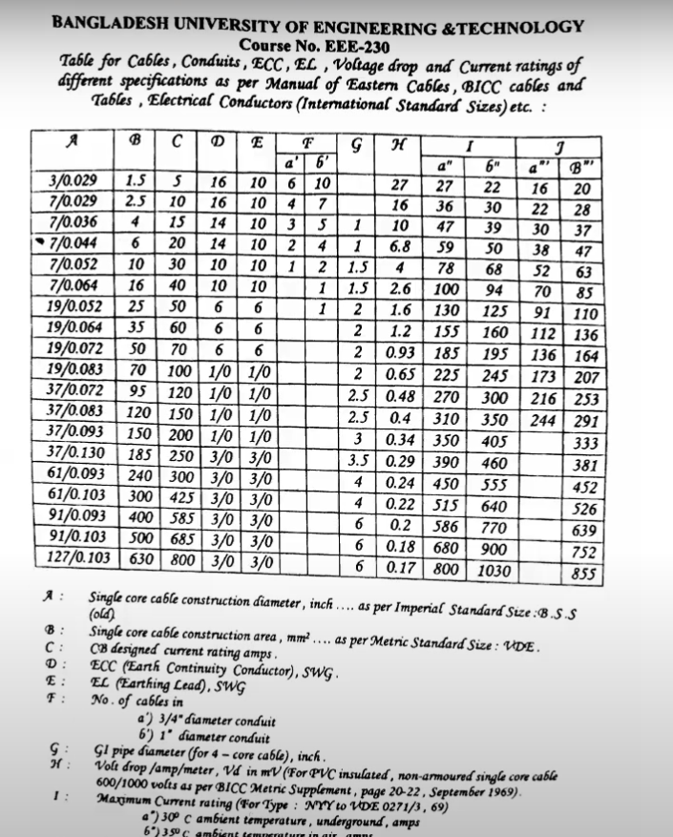
Conduit
B – Single core cable construction area (mm2)
C – Current Rating (A)
F – number of cables
(a) 3/4“ diameter conduit
(b) 1” diameter conduit
Light, Fan, 2pin Socket – 5A rating
Power (3 pin) Socket – 15A or 20A rating

Slide 36
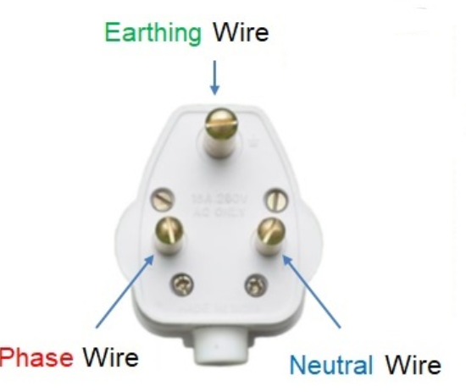
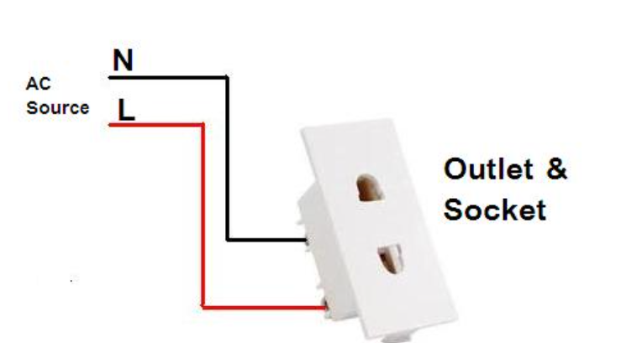
Conduit
Light, Fan, 2pin – Connected to SB – Connected to SDB – Connected to MDB
3pin Power Socket – Connected to SDB – Connected to MDB (ECC Needed)

Slide 37
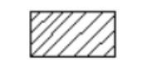

Conduit
C2
C1
SB
Fan
Bulb

Slide 38
Conduit
C1
C3
C1
SB
Fan

Slide 39
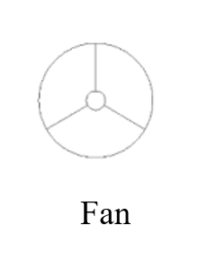
Conduit
C1
C4
C1
SB
C1

Slide 40

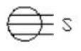
Conduit (Power Socket)
C8
C10
SDB
15A
15A
C10 = 2C8 = 4x4mm2 BYM + 2x4 BYA ECC

Slide 41
Conduit (Power Socket)
C9
C8,9
SDB
15A
20A
C8,9 = C8 + C9

Slide 42
Conduit (Power Socket)
C8
C8,9
SDB
20A
15A
C8,9 = C8 + C9

Slide 43
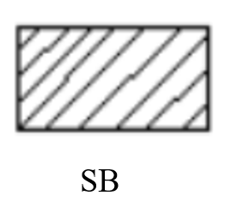
Conduit (Power Socket)
15A
20A
SDB
15A
15A

Slide 44
Conduit (Power Socket)
15A
20A
SDB
15A
15A

Slide 45
Conduit (Power Socket)
C8,9
15A
C9
20A
C2
C3
C1
??
C4
??
SDB
C1
C3
C10
C1
15A
C8
15A

Slide 46
Conduit
C8,9 = C8 + C9
C10 = 2C8 = 4x4 + 2x4 ECC

Slide 47
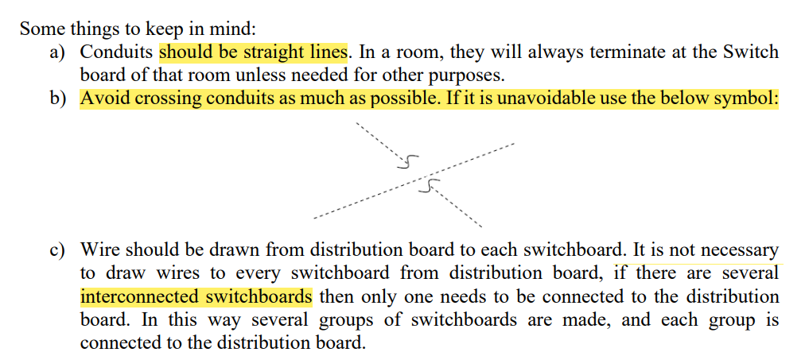
Conduit

Slide 48
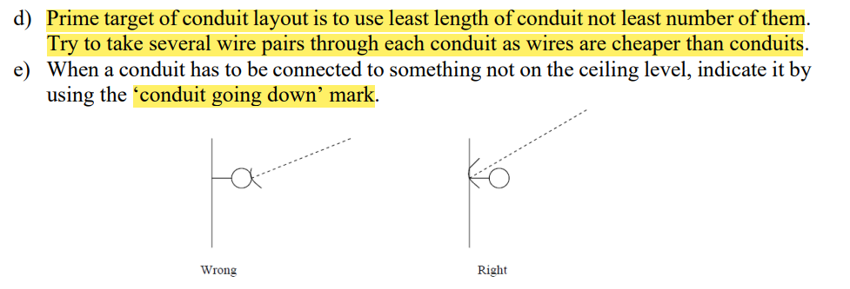
Conduit

Slide 49
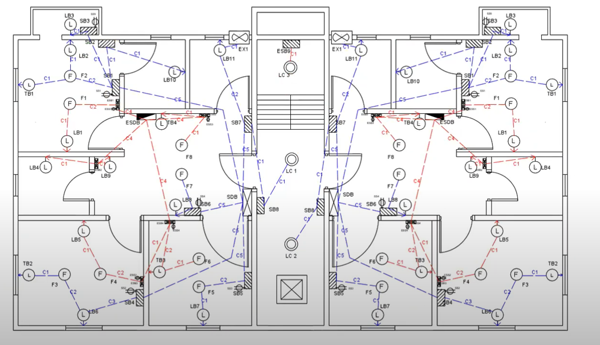
Conduit (Lighting Loads)
Normal Conduit
Emergency Conduit
SB
ESB
SDB
ESDB

Slide 50
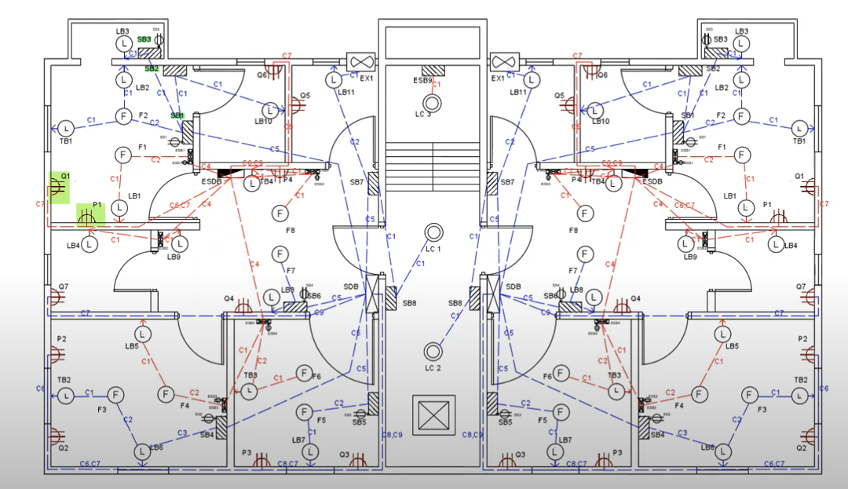
Conduit (Power Socket)
Power Sockets are directly connected to SDB

Slide 51
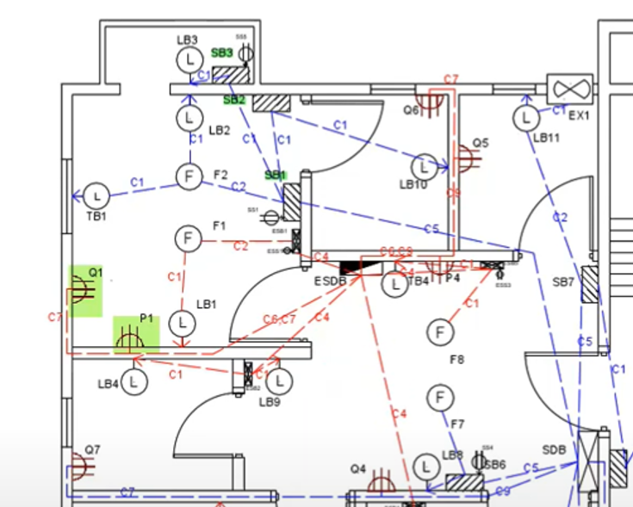
Conduit

Slide 52
Conduit (AutoCAD)
Create a New Layer
Line type – HIDDEN in AutoCAD
Specify LTS value

Slide 53
SB Diagram
ESB Diagram

Slide 54
Switch Board Diagram
Switch Board (SB) diagram
One SB for each room
Shows the connections from normal Light, Fan, 2pin sockets to SB
One SB can be connected to SDB via another SB
One Ckt for one connection from SB to SDB
Emergecny Switch Board (ESB) diagram
One ESB for each room
Shows the connections from emergency Light, Fan, 2pin sockets to ESB
One ESB can be connected to ESDB via another ESB
One Ckt for one connection from ESB to ESDB

Slide 55
Switch Board Diagram (Non-Emergency)
Normal Conduit
Emergency Conduit
SB
ESB
SDB
ESDB

Slide 56
Switch Board Diagram (Non-Emergency)
Normal Condition
Bedroom-1
1 Fan
2 Light
1 Two pin socket
Toilet-1
1 Light
Veranda
1 Light
1 Two pin socket

Slide 57
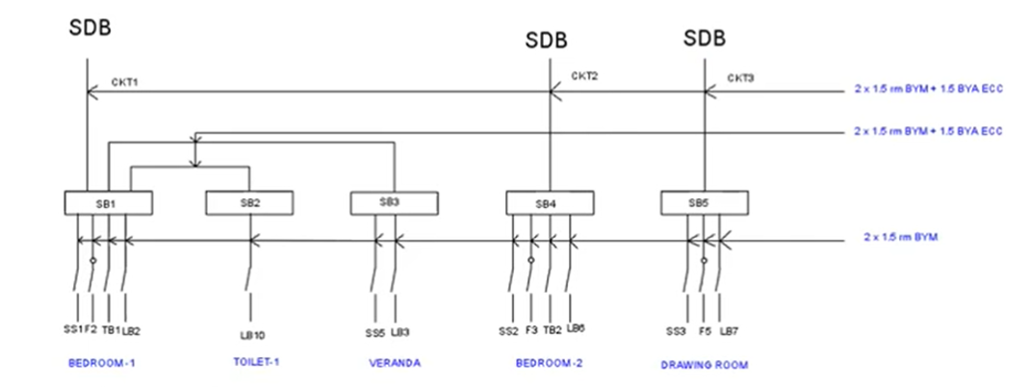
Switch Board Diagram (Non-Emergency)
5A Switches

Slide 58
Switch Board Diagram (Emergency)
Emergency Condition
Bedroom-1
1 Fan
2 Light
1 Two pin socket

Slide 59
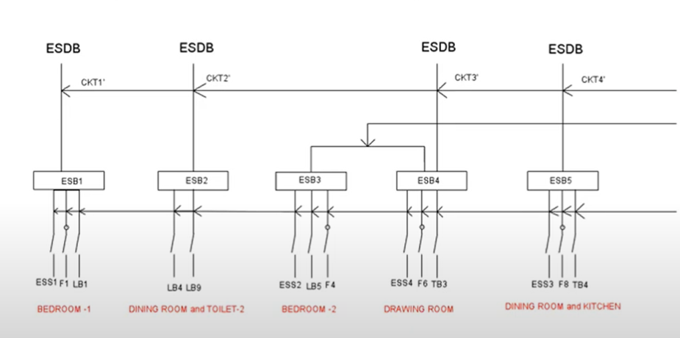
Switch Board Diagram (Emergency)
5A Switches

Slide 60
SB ESB Diagram
Total SB diagram
Unit-1
Unit-2
Ground Floor
Basement
Roof
Total ESB diagram
Unit-1
Unit-2
Ground Floor
Basement
Roof
Some Example Diagrams are presented in the next few slides

Slide 61
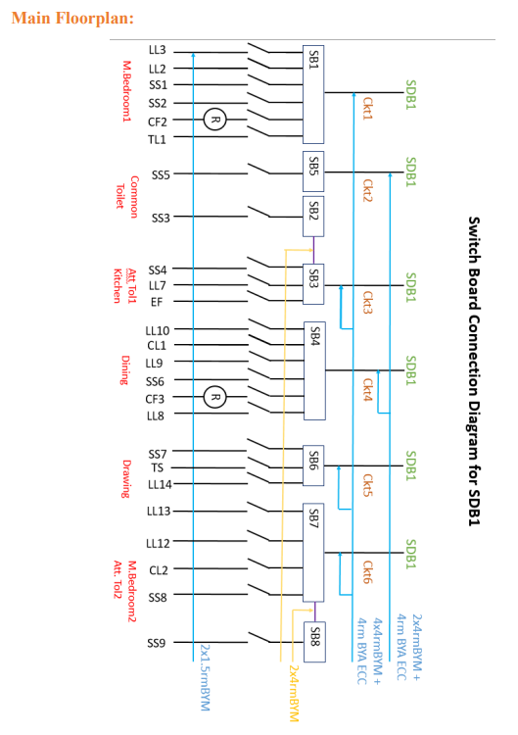
SB Diagram (Unit-1 and Unit-2)

Slide 62
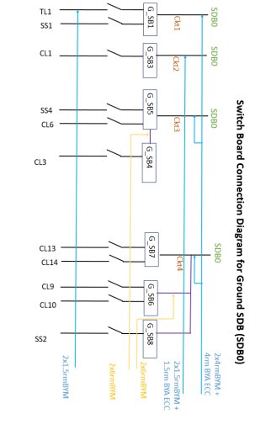
SB Diagram (Ground Floor)

Slide 63
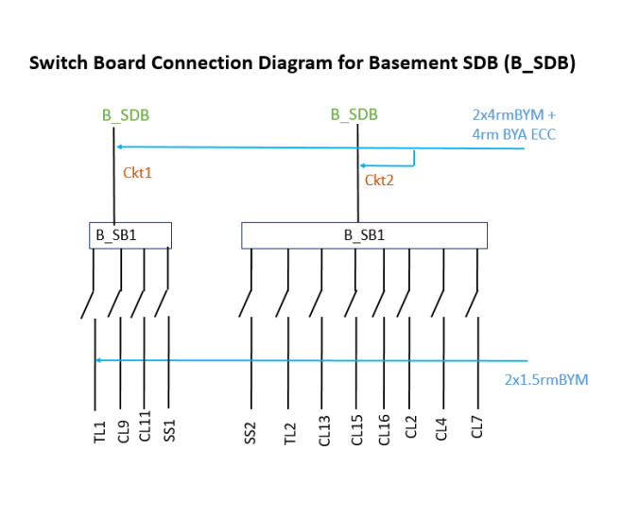
SB Diagram (Basement)

Slide 64

ESB Diagram (Unit-1 and Unit-2)

Slide 65

ESB Diagram (Basement)

Slide 66
SDB Diagram
ESDB Diagram

Slide 67
SDB and ESDB Diagram
Sub-Distribution Board (SDB) diagram
One SDB for each Unit, Ground, Basement and Roof
Shows the connections from SB to SDB
Power Sockets are Directly Connected to SDB
Emergency Sub-Distribution Board (ESDB) diagram
One ESDB for each Unit, Ground, Basement and Roof
Shows the connections from ESB to ESDB
Emergency Power Sockets are Directly Connected to ESDB

Slide 68
SDB and ESDB of Unit-1 and Unit-2

Slide 69
SDB and ESDB of Ground Floor

Slide 70
SDB and ESDB of Basement

Slide 71

SDB Diagram (Unit 1 and 2)

Slide 72
SDB Diagram (Unit 1 and 2)
Circuit Breakers

Slide 73

ESDB Diagram (Unit 1,2 and Ground)
SDB or ESDB of ground floor should have all the SB connections of
Stair Lights
Common Space appliances

Slide 74
Connection Flow
Light, Fan, 2pin 3pin
SB --------→ SDB ----------→ MDB ---→ Tx --→ Grid
ESB --------→ ESDB -------→ EMDB
Light, Fan, 2pin 3pin

Slide 75
ECC Connection
Light, Fan, 2pin 3pin
SB --------→ SDB ----------→ MDB ---→ Tx --→ Grid
ESB --------→ ESDB -------→ EMDB
Light, Fan, 2pin 3pin
ECC
ECC
ECC
ECC
ECC
ECC
ECC
ECC
ECC
ECC not needed for:
Fittings to SB and ESB

Slide 76
Connection Flow
Light, Fan, 2pin 3pin
SB --------→ SDB ----------→ MDB ---→ Tx --→ Grid
ESB --------→ ESDB -------→ EMDB
Light, Fan, 2pin 3pin
1 Diagram
5 Diagram
5 Diagram
5 Diagram
5 Diagram
1 Diagram

Slide 77
SDB ESDB Diagram
Total SDB diagram
Unit-1
Unit-2
Ground Floor
Basement
Roof
Total ESDB diagram
Unit-1
Unit-2
Ground Floor
Basement
Roof

Slide 78
MDB EMDB Diagram

Slide 79
MDB and EMDB Diagram
Main-Distribution Board (MDB) diagram
One MDB for the building
Shows the connections from SDB to MDB
Pump, PFI plant, EMDB connection
Emergency Main-Distribution Board (EMDB) diagram
One EMDB for the building
Shows the connections from ESDB to EMDB
EMDB is connected to MDB via ATS and Generator

Slide 80

A Typical Model for MDB Diagram

Slide 81
MDB Diagram
Sample Calculation
Total Number of SDB Connected to MDB = 21
9 Apartments * 2 units Each = 18
Ground Floor = 1
Basement = 1
Roof = 1
7 SDB connected to each phase ( 21/3 = 7 )

Slide 82
MDB Diagram
21 SDB
7 + 7 + 7

Slide 83

MDB Diagram Example

Slide 84

EMDB Diagram

Slide 85
SB ESB Diagram Calculations

Slide 86
Calculation For SB Diagram
C9

Slide 87

Calculation For SB Diagram
P = V*I*pf
V = 230V rms
pf = 0.7 to 0.8
V = Phase Voltage
I = Phase Current = Line Current
pf = Power Factor

Slide 88

Calculation For SB Diagram
Y-Y Connection
P = V*I*pf
V = 230V rms
pf = 0.7 to 0.8
V = Phase Voltage
I = Phase Current = Line Current
pf = Power Factor

Slide 89
Calculation For SB Diagram

Slide 90

Calculation For Cascaded SB Diagram
Bedroom-1
Ckt-1 / SB1
Total Load of Ckt-1 =
Load of SB1 + Load of SB2 + Load of SB3

Slide 91
SDB ESDB Diagram Calculations

Slide 92

Calculation For SDB Diagram

Slide 93
SB Diagram (Unit-1 and Unit-2)

Slide 94


SDB Calculation (Unit-1 and Unit-2)

Slide 95


SDB Calculation (Unit-1 and Unit-2)

Slide 96

Calculation For ESDB Diagram

Slide 97

ESB Diagram (Unit-1 and Unit-2)

Slide 98


ESDB Calculation (Unit-1 and Unit-2)

Slide 99

ESDB Calculation (Unit-1 and Unit-2)

Slide 100
EMDB Diagram Calculations

Slide 101
Connection Flow
Light, Fan, 2pin 3pin
SB --------→ SDB ----------→ MDB ---→ Tx --→ Grid
ESB --------→ ESDB -------→ EMDB
Light, Fan, 2pin 3pin

Slide 102

Calculation For EMDB Diagram
ESDB of all unit, ground,
basement and roof
Lift

Slide 103
Calculation For EMDB Diagram
Breaker Rating
ESDB of all unit, ground,
basement and roof
Lift

Slide 104
Calculation For EMDB Diagram
Total ESDB load
= Ground floor ESDB Load + Basement ESDB Load + 12 Unit ESDB Load
= 154 + 168 + 406 * 2
= 5040 W
Lift Load = 18.5 kW
EMDB Load
= Total ESDB load * 0.7 + Lift load * 0.7
= 16478 W
0.7 Diversity Factor

Slide 105
Calculation For EMDB Diagram
EMDB Load = 16.478 kW
Per Phase EMDB Load = (16478/3) W
EMDB Current = (16478/3) / (220*0.95) = 26.28 A
Circuit Breaker: 40A TP MCCB is needed from 3 phase supply to EMDB.
Generator: A 25kW Generator is used to supply the EMDB load through an ATS.
Use power factor 0.95 for EMDB

Slide 106

Generator Room
Table 8.1.24 is for general guidance, not mandatory . In BNBC 2006, this was the minimum requirement.

Slide 107

Generator Room

Slide 108
MDB Diagram Calculations

Slide 109
Connection Flow
Light, Fan, 2pin 3pin
SB --------→ SDB ----------→ MDB ---→ Tx --→ Grid
ESB --------→ ESDB -------→ EMDB
Light, Fan, 2pin 3pin

Slide 110

Calculation For MDB Diagram
SDB of all unit, ground,
basement and roof
Pump
PFI Plant
EMDB

Slide 111
Calculation For MDB Diagram
Breaker Rating
SDB of all unit, ground,
basement and roof
Pump
PFI Plant
EMDB

Slide 112
Calculation For MDB Diagram
Total SDB Load
= Ground SDB Load + Basement SDB Load + 12 Floor SDB Load
= 3784 + 84 + 6 * 2* 16372
= 200.332 kW
Pump Load = 5000 W
EMDB Load = 16478 W
MDB Load
= Total SDB Load ⨯ 0.7 + (EMDB Load + Pump Load) ⨯ 0.7
= 155267 W

Slide 113
Calculation For MDB Diagram
MDB Load = 155267 W
Per Phase EMDB Load = (155267 /3) W
MDB Current = (155267/3) / ( 220 * 0.95) = 217.63 A
Circuit Breaker: 220 A TP MCCB is needed from Main Line to MDB.
Pump Circuit Breaker Rating : Same approach
Use power factor 0.95 for MDB

Slide 114
PFI Plant and Transformer Calculations

Slide 115
Calculation For PFI Plant
MDB Load P = 155267 W
Initial Power Factor pf = cos Ѳ1 = 0.7
VAR Q = P*tanѲ1 = 155267*tan (cos-1 (pf)) = 158.404 kVAR
Per Phase VAR = (158.404 / 3) kVAR
Desired power factor = cos Ѳ2 = 0.95
After improvement, sinѲ2 = sin(cos-1 (0.95))
Current I = Per Phase VAR /(V*sinѲ2)
= (158.404/3) / (220* sin(cos-1 (0.95)))
= 240 A
Circuit Breaker: 240A TP MCCB is needed from PFI to MDB
Q
Ѳ1
P
Per Phase VAR =
V*I*sinѲ2

Slide 116
Transformer Calculation
Need of a Transformer: If total load is greater than 80kW.
Total Load = Summation of all loads in the building.
kVA Rating = Total Load /0.95*0.8
0.95*0.8 for power factor and safety factor

Slide 117


Choice for Transformer
For small building having moderate power rating up to 2 MW, two types of indoor transformers have been widely used recently.
(i) Oil Type Natural Cooled transformer (*ONAN)
(ii) Cast Resin Dry Type Natural Cooled (*AN) transformers
Oil Type Transformer
Dry Type Transformer

Slide 118

Transformer Room
Table 8.1.23 is for general guidance, not mandatory . In BNBC 2006, this was the minimum requirement.

Slide 119


11/0.4 kV Electrical Substation in a Building
All the 4 arrangements are for 11 kV transformer.

Slide 120

11/0.4 kV Electrical Substation in a Building

Slide 121



11/0.4 kV Electrical Substation in a Building

Slide 122
Transformer Room (Location)
The location of a substation will depend on (i) The feed point of the 11 kV Supply Authority line and (ii) The location of the LT vertical riser cables.
In a multi-storied building, the substation preferably shall be installed on the lowest floor level, but direct access from the street for installation or removal of the equipment shall be provided. The 11/0.4 kV SS shall not be placed in a basement.
The floor level of the substation shall be above or switch room the highest flood level of the locality. Suitable arrangements entrance should exist to prevent the of storm or flood water into the substation area.

Slide 123
Transformer Room (HT LT Panel Location)
In general, substation HT to LT transformer shall be placed in one corner of the room so that the HT side remains away from the passage of the persons.
The HT metering panel shall be located near exterior of the substation room near the exit gate and also shall be convenient for the HT cable entry.
LT panel shall remain at a sufficient distance from transformer but not too distance from the far away from the transformer. On the other hand, the location of the LT panel should such that the riser main cable can have their way upward or outward within very short distance.
The flow of electric power is from supply company network to HT room, then to transformer and finally to the low voltage switchgear room.

Slide 124


11/0.4 kV Electrical Substation in a Building

Slide 125
Lightning Protection System LPS Design

Slide 126


LPS Design
A lightning protection system is a passive means of preventing life and property damage from the effects of a lightning strike.
It works by providing the electric charge produced by the clouds a path of least resistance to the ground.

Slide 127
LPS Design
Index Figures Associated with Lightning Protection Design
• A: Use of Structure (2-10)
• B: Type of Construction (1-10)
• C: Contents or Consequential Effects (2-10)
• D: Degree of Isolation (2-10)
• E: Type of Terrain (2-8)
• F: Height of Structure (2-30)
• G: Lightning Prevalence (2-21)
Point range within parenthesis ().
***Total summed up index over 40 indicates that Linghtning Protection is essential
Index Figures Associated with Lightning Protection Design • A: Use of Structure (2-10) • B: Type of Construction (1-10) • C: Contents or Consequential Effects (2-10) • D: Degree of Isolation (2-10) • E: Type of Terrain (2-8) • F: Height of Structure (2-30) • G: Lightning Prevalence (2-21) * Point range within parenthesis (). Total summed up index over 40 indicates that Linghtning Protection is essentia

Slide 128


LPS Design
• A: Use of Structure (2-10) • B: Type of Construction (1-10)

Slide 129


LPS Design
• C: Contents or Consequential
Effects (2-10)
• D: Degree of
Isolation (2-10)

Slide 130



LPS Design

Slide 131

LPS Design
A complete lightning protection system shall consist of
• Air Spike or Air Terminal
• Down Conductor
• Roof Conductor and
• Earth Electrode
• Earth Inspection Boxes
• Earthing Pit

Slide 132

LPS Design

Slide 133


LPS Design

Slide 134

LPS Design
LPS Design Parameters
Lightning Arrestor Rod Height = 2 feet
We place arrestors 25 feet apart
Number of Arrestor = Roof Perimeter (feet) / 25
Roof perimeter = 2* (80'6” + 43') = 247’
Number of Arrestor = 247/25 = 9.88
So, 10 arrestors needed along the perimeter.

Slide 135


LPS Design
4 arrestors along the length of the roof perimeter
3 arrestors along the width
4 on the corners of the stair-room

Slide 136
LPS Design
Calculation of Down Conductor
• A building with a base area not exceeding 100 sq. meter shall be provided with one down conductor.
• For a larger building, there shall be one down conductor for the first 80 m2 plus a further one for every 100 m2 or part thereof in excess of the first 80 m2.
Down conductor Example:
Area = 321.58 sq. meter > 100 sq. meter
For first 80 sq. meter = 1 down conductor
For next areas = (321.58 - 80)/100 = 2.4 or 3
Total Number = 4
Roof conductor: Roof conductors relate to all the arrestor and ground electrode.

Slide 137


LPS Design
Protection Zone The zone of protection is the space within which an air spike provides protection by attracting the stroke to itself.
Protected Zone for Vertical Conductors
Protected Zone for Horizontal Conductors

Slide 138
Rolling Sphere Design
• The rolling ball or more correctly the rolling sphere method uses an imaginary spherical shaped ball with a 150-foot radius or 300-foot diameter that rolls over the building structure touching only the tips of the air terminals mounted on the roof.
• This dimension is based on the fact that the lightning strike distance near the surface of the earth is about 150 ft. or less. The sphere is tangent to earth and will contact three or more correctly spaced air terminals when rolled over any portion of the roof structure.

Slide 139


Rolling Sphere Design

Slide 140
Rolling Sphere Design
• When using this imaginary sphere and rolling up over and down the other side of the building, it will only touch the roof mounted air terminals, never the building structural roof surfaces.
• When using the spherical shape to determine the zone of protection for the building structure all possible placements of the sphere on the structure shall be considered for terminal placement.
• A protected building that exceeds the height of the lower building structure will protect the lower structure when it lies within the zone of protection of the rolling sphere. Remember that the protective sphere has a 150 ft. radius or is really a 300 foot diameter round ball.

Slide 141

Rolling Sphere Design

Slide 142

Rolling Sphere Design

Slide 143
Thank You

